Slide 1
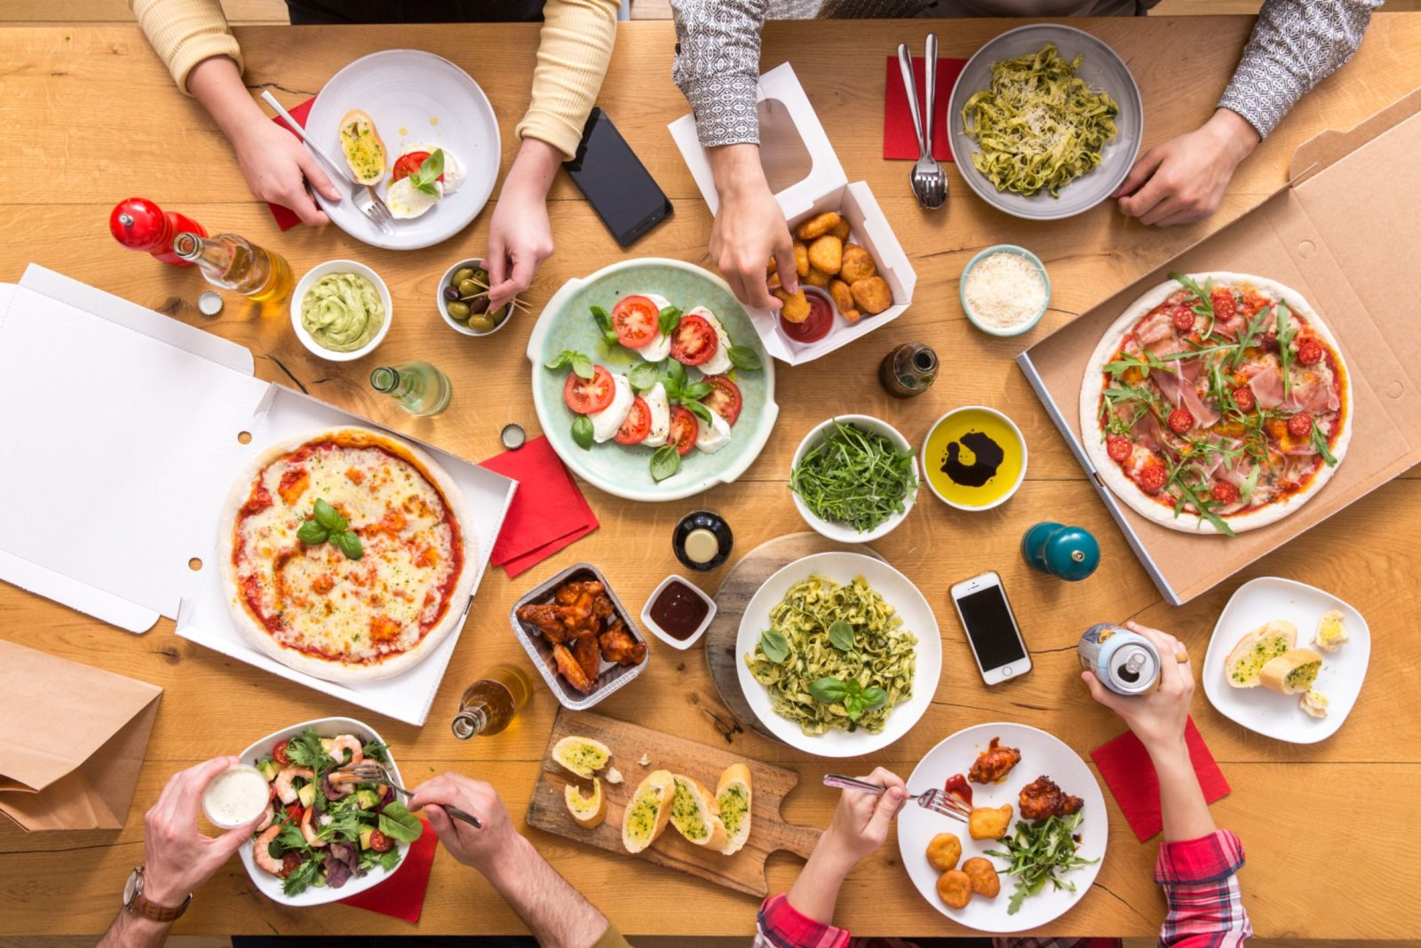






ONLINE PRE ORDERING SYSTEM
FOR RESTAURANTS
INTRODUCING TO SIMME PLATFORM

Slide 2
PROBLEM IDENTIFICATION
OFFLINE OPERATING RESTAURANTS
Orders takes long time to deliver in the kitchen
Restaurant Administration Issues / Papers missing
Customer Order is Taken Manually
Ran out of Paper for new customer order
Manual Management / Paper Based

Slide 3
CASE ANALYSIS
OPERATING RESTAURANTS
Waiters
Digitalization
No Human Involvement
Order Tools
Menu/Time/Restaurant
Track Orders
...
WHAT?

Slide 4
CASE ANALYSIS
OPERATING RESTAURANTS
Today`s World
Increase Profit
Customer Satisfaction
User Friendly
Increase of online usage
WHY?

Slide 5
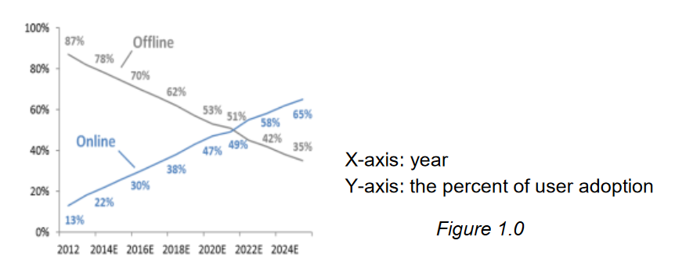
Statistics / charts of customer
CASE ANALYSIS
OPERATING RESTAURANTS
WHY?

Slide 6
CASE ANALYSIS
OPERATING RESTAURANTS
Restaurants
Res. Chains
Franchisees
Shopping Malls
Worldwide
...
WHERE?

Slide 7
CASE ANALYSIS
OPERATING RESTAURANTS
Convenience
Simme Platform
Commission
Ads
...
HOW?

Slide 8
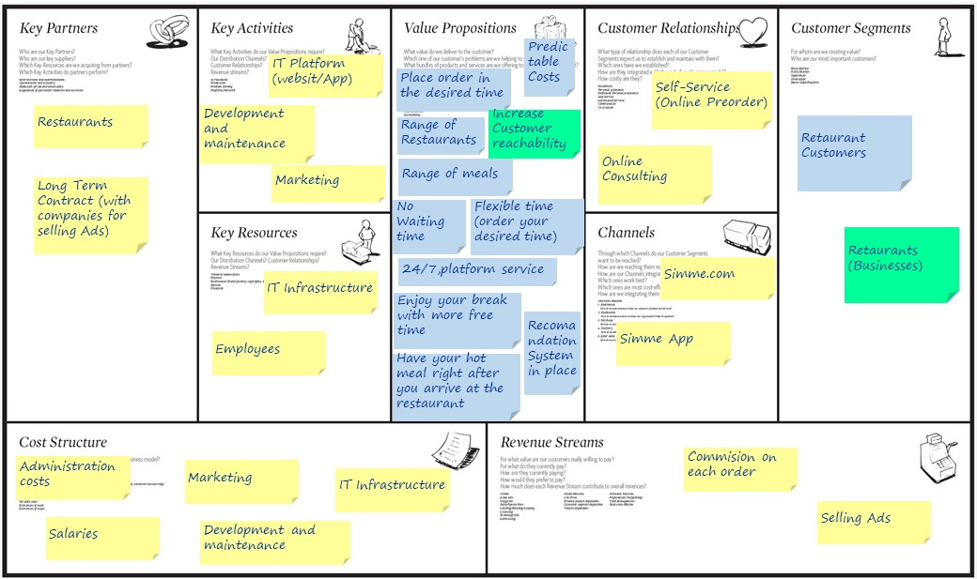
BUSINESS MODEL
SIMME PLATFORM

Slide 9
SOLUTION
SIMME PLATFORM

Slide 10
BENEFITS
SIMME PLATFORM

Slide 11
We appreciate your attention!
Thank You!
Questions? Feedbacks? Remarks?

